Slide 1
LibraryDeskSense
An IoT-based Monitoring System for Library study Desks
Hedi Hechmi
Electronics for Intelligent Systems, Big Data and Internet of Things
July 7, 2026
Notes:
Good morning Professor. My name is Hedi Hechmi, and today I'll present LibraryDeskSense, an IoT-based monitoring system developed for the Internet of Things course.
The goal of the project is to monitor library study desks in real time tracking occupancy, ambient noise, and lighting conditions.

Slide 2
Problem and Motivation
• Libraries and study rooms are shared spaces where finding the right desk is a challenge
• Students want to know:
- Is a desk free or occupied?
- Is the area quiet enough to study?
- Is the lighting good for reading?
• Traditional solutions only count people at the entrance — no desk-level info
• Our goal: build a low-cost IoT system that monitors each desk in real time
Notes:
Libraries and study rooms are shared spaces used by many students. Currently, if you want to find a good desk, you have to walk around and check each one manually which is time-consuming. Traditional occupancy solutions only count how many people enter the library, but they don't tell you which specific desks are available, or which areas are quiet, or which have good lighting.
Our project addresses this by placing a small, low-cost sensor node on each desk. This node monitors three things in real time: whether the desk is occupied, the ambient noise level, and the lighting intensity. All this information is sent to a central dashboard that students and librarians can access

Slide 3
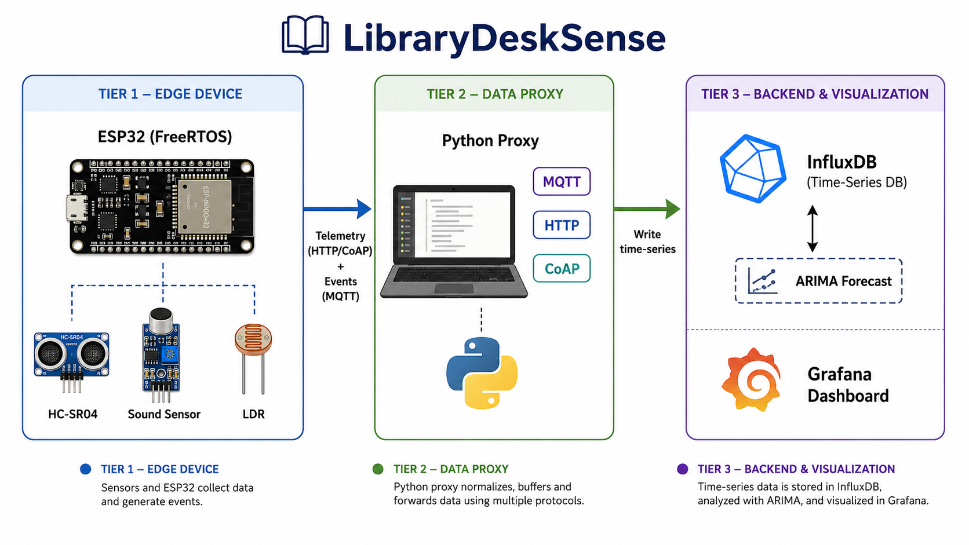
System Architecture
Notes:
The system follows a classic three-tier IoT architecture. On the left, we have
Tier 1, the Edge an ESP32 microcontroller connected to three sensors: an ultrasonic sensor for occupancy detection, a sound sensor for noise, and a light-dependent resistor for ambient lighting.
In the middle,
Tier 2 is the Data Proxy, a Python application running on the laptop. It receives telemetry from the ESP32 through MQTT, HTTP, or CoAP, and forwards it to the database.
On the right,
Tier 3 is the Backend: InfluxDB stores all the time-series data, and Grafana visualizes it in real time on a dashboard. There's also an ARIMA forecasting module that predicts future noise and light levels.

Slide 4
Hardware setup
• ESP32 DevKit V1 microcontroller (Wi-Fi + Bluetooth, 240 MHz, 4 MB flash)
• HC-SR04 ultrasonic sensor → occupancy detection (GPIO 5 / 18)
• Analog sound sensor → noise level via ADC (GPIO 35)
• LDR + voltage divider → light intensity via ADC (GPIO 34)
• 12-bit ADC (0–4095) with 12 dB attenuation for full 3.3 V range
Notes:
The hardware setup uses an ESP32 DevKit V1, which is a low-cost microcontroller with built-in Wi-Fi and Bluetooth. Three sensors are connected to it:
First, the HC-SR04 ultrasonic sensor for occupancy detection. It measures distance by emitting a sound pulse and timing the echo. If the distance is below 50 cm, we consider the desk occupied. It's connected to GPIO 5 for the trigger signal and GPIO 18 for the echo.
Second, an analog sound sensor connected to GPIO 35. Since GPIO 35 is one of the ESP32's input-only ADC pins, it's perfect for reading the analog voltage from the microphone.
Third, a light-dependent resistor forming a voltage divider with a 5 kΩ resistor, connected to GPIO 34 — also an ADC input. The LDR's resistance changes with light, and the voltage divider converts that into a voltage the ADC can read.
All ADC channels use 12-bit resolution and 12 dB attenuation, giving us a full 0–3.3 V input range with values from 0 to 4095

Slide 5
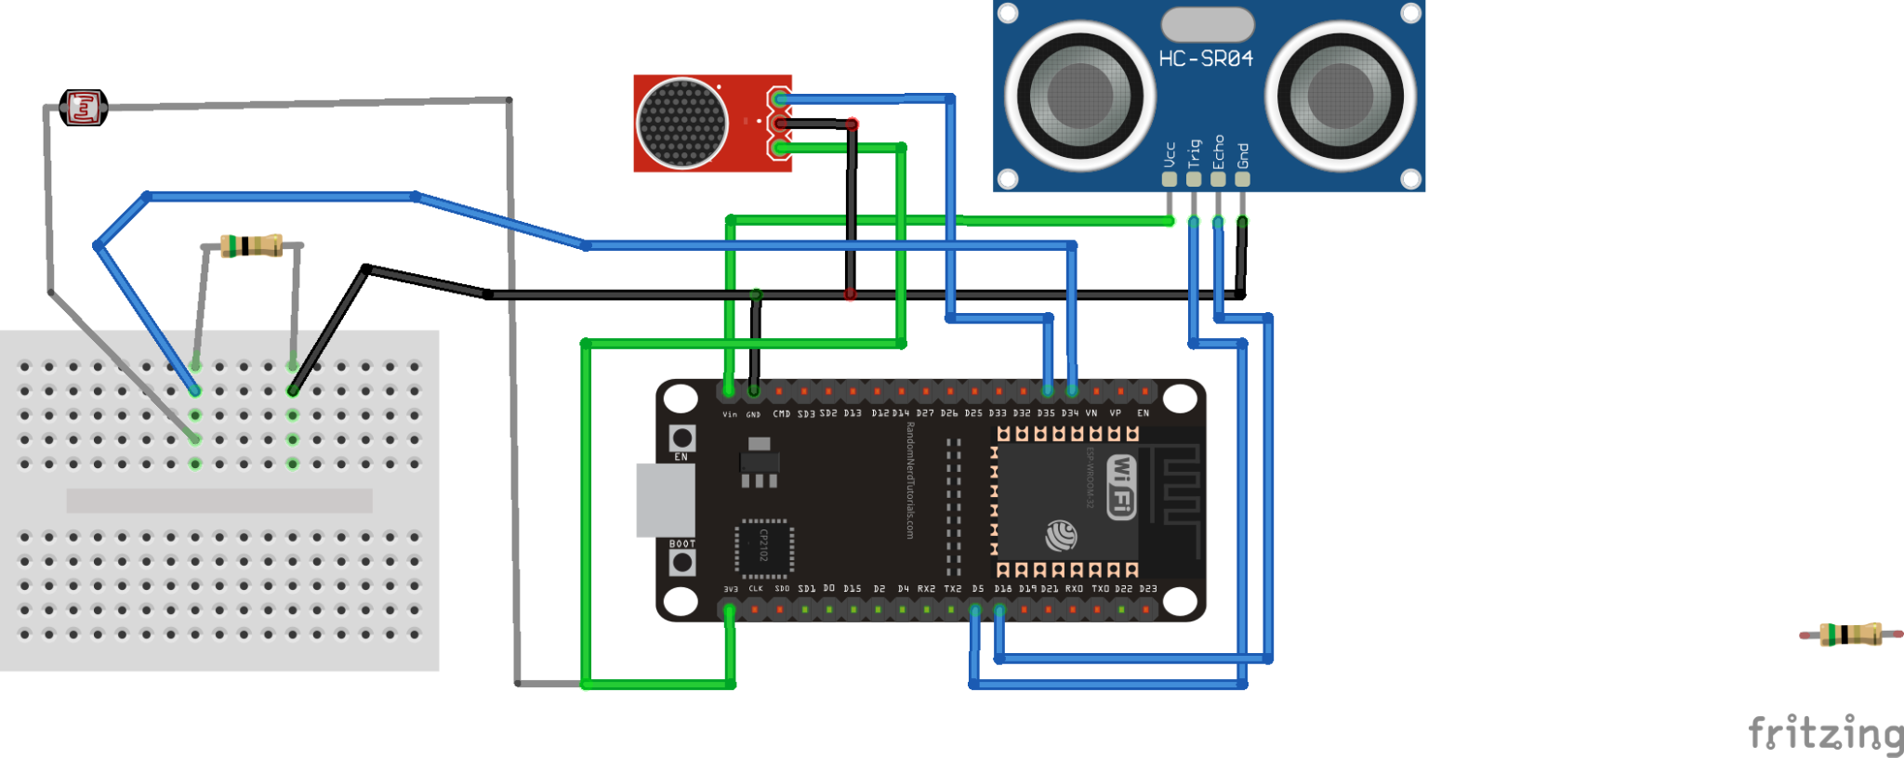
Circuit Diagram
Notes:
Here is the actual wiring diagram. I used Fritzing to create it. Fritzing is a free, open-source electronics design tool.
On the right, the HC-SR04 ultrasonic sensor is connected to GPIO 5 for the trigger and GPIO 18 for the echo.
In the middle, the sound sensor's analog output is connected to GPIO 35.
On the left, the LDR forms a voltage divider with a fixed resistor, with the midpoint connected to GPIO 34.
The ultrasonic sensor and the LDR share a 5V power supply, while the sound sensor is powered by 3.3V. All three sensors share a common ground with the ESP32.

Slide 6
ESP32 Firmware — FreeRTOS Architecture
• Built with ESP-IDF v5.3.5 (no Arduino) — 4 concurrent FreeRTOS tasks
• Occupancy Task (1s) — reads HC-SR04 distance, sets occupied flag
• Noise Task (500ms) — 100 rapid ADC samples, computes peak-to-peak
• Light Task (2s) — single ADC read from LDR voltage divider
• Event Task (configurable) — publishes telemetry + detects events
• 2 Mutexes protect shared resources:
- data_mutex → shared sensor variables
- adc_mutex → ADC1 hardware access
• Snapshot pattern: brief lock → copy to local vars → unlock → work
Notes:
The firmware is built with ESP-IDF version 5.3.5, not Arduino, as required by the project. It uses FreeRTOS, a real-time operating system, to run four tasks concurrently.
The Occupancy Task runs every second and reads the ultrasonic sensor to detect if someone is at the desk. The Noise Task runs twice per second and takes 100 rapid ADC samples to compute the peak-to-peak noise level. The Light Task runs every two seconds and reads the LDR voltage. Finally, the Event Task publishes telemetry and detects state changes.
To handle shared resources safely, I used two mutexes. The data_mutex protects the shared sensor variables that all tasks read and write. The adc_mutex protects the ADC1 hardware, because two tasks( noise and light ) both use it and cannot access it at the same time.
I used the snapshot pattern: each task briefly locks the mutex, copies the shared data into local variables, unlocks, and then works only on the local copies. This minimizes lock time and prevents blocking other tasks.

Slide 7
Communication Protocols — MQTT, HTTP, CoAP
• Three protocols, each with a specific role:
• MQTT (TCP) — asynchronous events + runtime configuration
- Publish: telemetry, occupancy, noise, lighting events
- Subscribe: 5 config topics (thresholds, sampling rate, mode)
• HTTP (TCP) — telemetry via POST /telemetry
- Reliable, heavy headers (~200–500 bytes)
• CoAP (UDP) — telemetry via non-confirmable POST
- Lightweight (~15–50 bytes), fast, connectionless
• Runtime protocol switching via MQTT topic:
desk/config/communication_mode → "mqtt" | "http" | "coap"
Notes:
The system uses three protocols, each playing a different role.
MQTT is used for asynchronous event notifications and runtime configuration. It runs on TCP through a Mosquitto broker on my laptop. The ESP32 publishes telemetry and event messages, and subscribes to five configuration topics that let me change thresholds, sampling rate, and the active communication mode all at runtime, without reflashing.
HTTP is one of the two options for telemetry. It uses TCP, which is reliable, but the headers are heavy around 200 to 500 bytes per message.
CoAP is the second telemetry option. It uses UDP, which is connectionless and much lighter around 15 to 50 bytes per message. I use non-confirmable messages, meaning the ESP32 does not wait for acknowledgment, making it very fast.
The user can switch between HTTP and CoAP at runtime simply by publishing to the "communication_mode" MQTT topic. This allows dynamic protocol comparison, which is exactly what I use for the benchmark.

Slide 8
Runtime Configuration via MQTT
• All key parameters can be changed live — no reflash needed
• 5 subscribed configuration topics:
- desk/config/sampling_rate → event loop period (ms)
- desk/config/noise_thr → high-noise threshold
- desk/config/light_thr → poor-lighting threshold
- desk/config/occupancy_thr → distance threshold (cm)
- desk/config/communication_mode → mqtt / http / coap
• Example (change noise threshold to 300):
mosquitto_pub -h localhost -t desk/config/noise_thr -m "300"
• ESP32 MQTT callback parses payload and updates global variable
• Enables live demo, adaptive tuning, and protocol switching
Notes:
One of the required features is runtime configuration. The ESP32 subscribes to five MQTT topics that let me change important parameters without reflashing the device.
I can update the sampling rate, the noise threshold, the light threshold, the occupancy distance threshold, and even the active communication mode switching between MQTT, HTTP, and CoAP live.
For example, if I want to make the system more sensitive to noise, I just publish a new value like "300" to the noise threshold topic using the Mosquitto publish command. The ESP32's MQTT event handler receives the message,and updates the corresponding global variable.
This makes the system flexible: I can tune it in real time during my live demo, and it also enables the protocol comparison I can benchmark HTTP versus CoAP simply by switching modes over MQTT.

Slide 9
Backend — Python Proxy, InfluxDB, Grafana
• 3-tier backend, all running on my laptop
• Python Proxy (proxy.py):
- MQTT subscriber → listens to desk/# topics
- Flask HTTP server → POST /telemetry endpoint (port 8080)
- Writes every message to InfluxDB
• InfluxDB 2.7 — time-series database
- Org: LibraryDeskSense | Bucket: library_desk
- Measurements: telemetry, event, forecast
• Grafana 11.4 — visualization dashboard
- Flux queries against InfluxDB
- 6 panels, auto-refresh every 1s
• Mosquitto 2.1 MQTT broker — runs as Windows service
Notes:
The backend has three tiers, all running on my laptop.
The first tier is the Python Proxy, which I wrote in proxy.py. It runs two things in parallel using threading: an MQTT subscriber that listens to all "desk/" topics, and a Flask HTTP server on port 8080 that accepts telemetry via POST. Every message it receives is immediately written to InfluxDB it does not store anything itself.
The second tier is InfluxDB 2.7, a time-series database optimized for sensor data. I created an organization called LibraryDeskSense and a bucket called library_desk. Data is stored in three measurements: telemetry for sensor readings, event for occupancy and threshold events, and forecast for ARIMA predictions.
The third tier is Grafana 11.4, which queries InfluxDB using Flux and displays six real-time panels that refresh every second.
The MQTT broker itself is Mosquitto 2.1, running as a Windows service on port 1883.

Slide 10
Grafana Dashboard — Real-Time Monitoring
• 6 live panels, refreshing every 1 second
• Desk Status — OCCUPIED 🪑 (red) / FREE ✅ (green)
• Recent Events — colored table (occupied, released, high noise, poor light)
• Noise Level — time series with threshold line at 200
• Light Intensity — time series with threshold line at 1000
• Desk Distance — ultrasonic reading in cm
• Noise: Real vs Forecast — actual data + ARIMA prediction overlay
Notes:
The Grafana dashboard is the main visualization for the system. It has six panels, all refreshing every second.
The first panel is the Desk Status - a large Stat panel showing OCCUPIED in red or FREE in green, based on the latest occupancy value.
The second panel is the Recent Events table, which lists the last 30 events with colored rows: blue for occupied, green for released, red for high noise, and orange for poor lighting.
The next three panels are time series charts for noise, light, and distance. The noise chart has a red threshold at 200, and the light chart has a threshold at 1000 with reversed colors — red below means poor lighting.
The last panel shows Noise Real vs Forecast. It overlays the actual measured noise (in blue) with the ARIMA forecast (in red dashed line) — this is where the forecasting module becomes visible to the user.
I'll show this dashboard live during the demo.

Slide 11
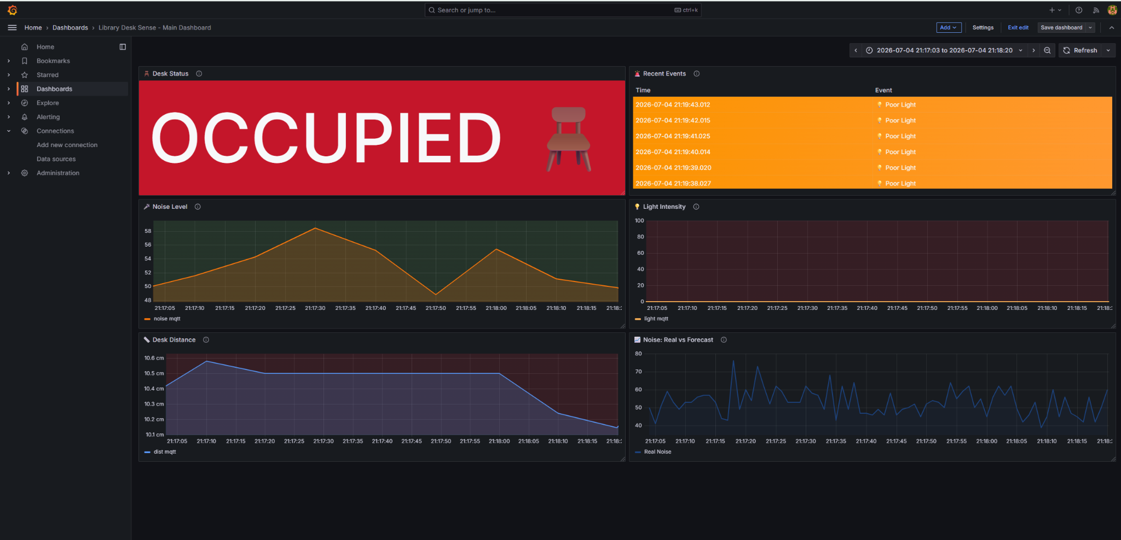
Grafana dashboard
Notes:
As we see those the 6 panels from the grafana dashboard

Slide 12
Forecasting — ARIMA Model for Noise Prediction
• Python module (forecast.py) runs every 60 seconds
• Reads last 30 minutes of noise data from InfluxDB
• ARIMA(2,1,2) — 2 AR terms, 1 differencing, 2 MA terms
• Train/Test split: 80% / 20% for evaluation
• Metrics on test set:
- MAE ≈ 16.5 (avg error in noise units)
- MSE ≈ 409.6
• Forecast: 300 future points → written back to InfluxDB
• Old forecasts deleted before each cycle (avoids overlap)
• Displayed live in Grafana: Real vs Forecast overlay
Notes:
For the analysis module, I implemented forecasting using ARIMA — Auto-Regressive Integrated Moving Average — in a Python script called forecast.py that runs continuously every 60 seconds.
Each cycle, it reads the last 30 minutes of noise data from InfluxDB using a Flux query. I chose ARIMA with order (2,1,2) — two autoregressive terms, one differencing step to make the series stationary, and two moving average terms.
To evaluate accuracy, I split the data 80/20 into train and test sets, fit the model on the training data, and compare predictions to the test set. The results are MAE around 16.5 and MSE around 409.6, meaning on average the prediction is off by about 16 noise units.
Because ambient noise is stochastic talking, claps, background sounds are unpredictable — the forecast tends to converge to the local mean, which is expected behavior for this type of signal.
After evaluation, I refit the model on the full series and forecast 300 future seconds, writing them back to InfluxDB as a separate "forecast" measurement. Old forecasts are deleted first to avoid overlapping predictions appearing as a thick band in Grafana.
The result is visualized live in the Real vs Forecast panel of the dashboard.

Slide 13
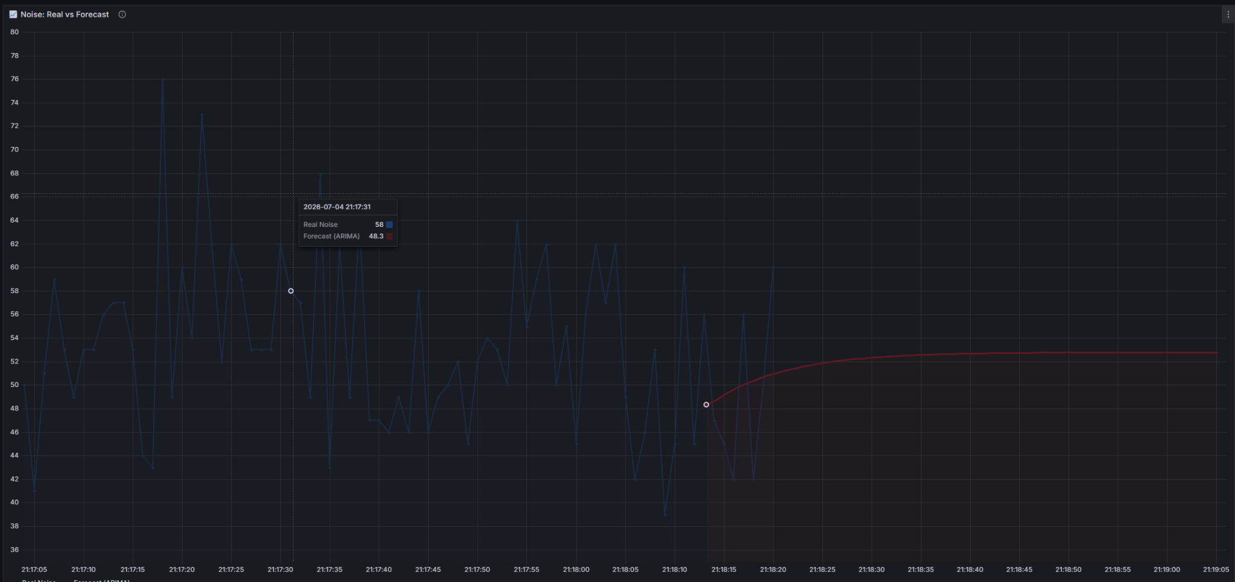
Real vs Forecasting
Notes:
The red line represent the prediction

Slide 14
Communication Overhead — HTTP vs CoAP
• Python benchmark (benchmark.py) — 100 messages per protocol
• Identical JSON payload for fair comparison
• Metrics measured: RTT, payload size, success rate
• Results (100 messages, localhost):
Metric HTTP CoAP
-------------------------------------
Success rate 100% 100%
Payload (bytes) 71.9 71.9
Avg RTT 6161 ms 2.27 ms
Median RTT 6155 ms 1.78 ms
• CoAP is ~2700× faster than HTTP
• Both deliver 100% of messages, same payload size
• Trade-off: HTTP = reliable + rich headers, CoAP = fast + lightweight
Notes:
To evaluate the communication overhead, I wrote benchmark.py which sends 100 identical JSON messages using each protocol and measures round-trip time, payload size, and success rate.
Both protocols delivered 100% of messages successfully, and the payload size is identical — about 72 bytes — because the JSON content is the same. The difference is in speed: HTTP averaged around 6100 milliseconds per round-trip, while CoAP averaged only 2.27 milliseconds. That is roughly 2700 times faster.
The reason for this big gap is that HTTP uses TCP, which requires connection setup, acknowledgments, and heavy headers. CoAP uses UDP with non-confirmable messages, which skips the handshake and adds almost no overhead.
The trade-off is clear: HTTP is more reliable and has rich header support — better for critical data. CoAP is much lighter and faster — better for high-frequency telemetry on constrained IoT devices.
In my system, this is why MQTT handles events and configuration (through TCP reliability), while telemetry can use either HTTP or CoAP depending on the deployment needs.

Slide 15
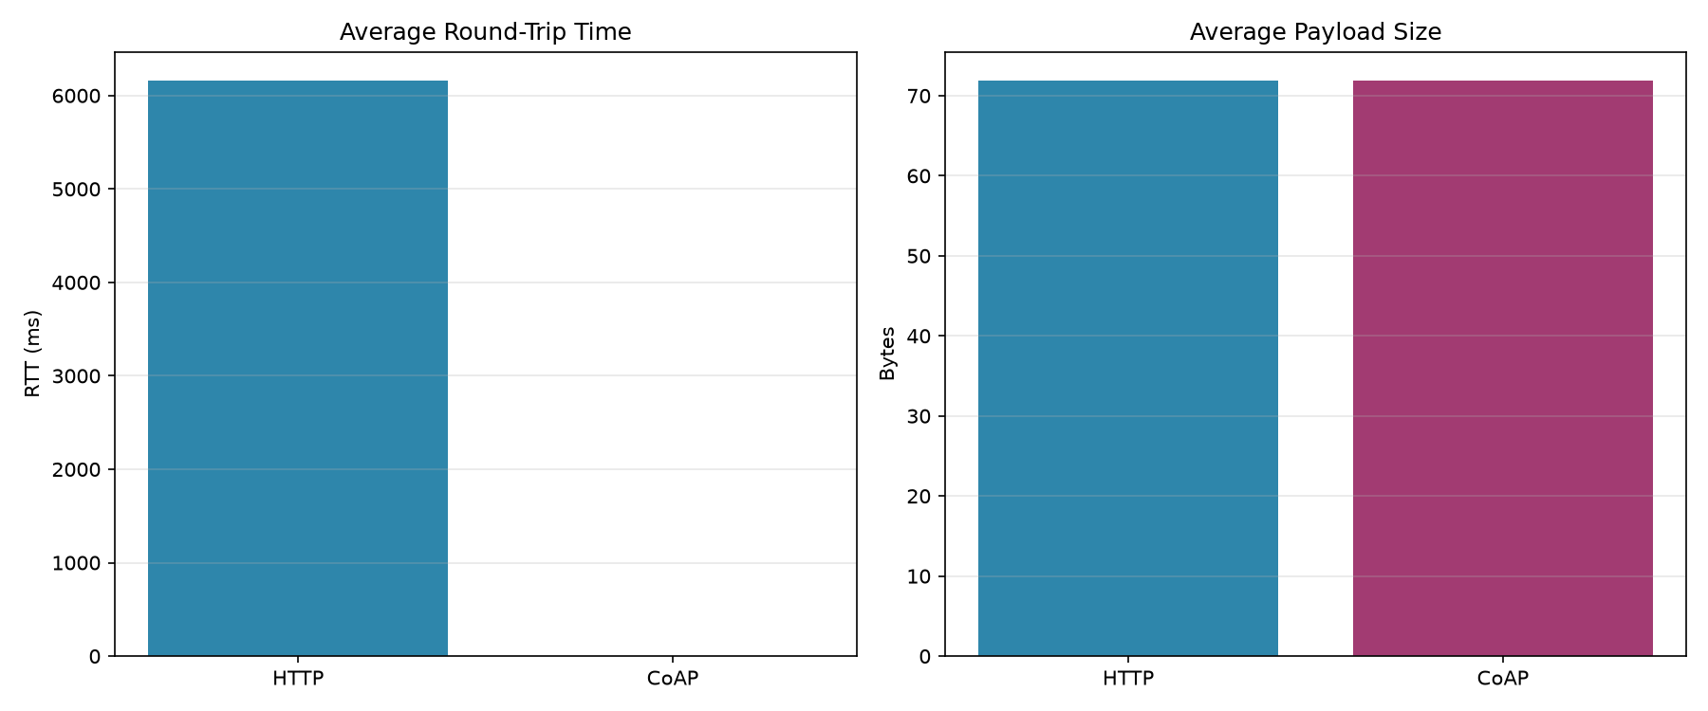
Benchmark comparison

Slide 16
Conclusion
• Delivered a fully working IoT system covering all requirements:
✔ ESP32 firmware with FreeRTOS (4 tasks, 2 mutexes)
✔ 3 sensors: occupancy, noise, light
✔ 3 protocols: MQTT, HTTP, CoAP
✔ Runtime configuration via MQTT (5 parameters)
✔ Python proxy + InfluxDB + Grafana (6 panels)
✔ ARIMA forecasting with MAE/MSE evaluation
✔ HTTP vs CoAP benchmark
• Key findings:
- CoAP ~2700× lower RTT than HTTP (same payload, same reliability)
- ARIMA effective as short-term baseline for noise prediction
• LibraryDeskSense demonstrates a complete end-to-end IoT pipeline:
from embedded sensing → to data storage → to visualization and analysis
Notes:
To conclude, I delivered a fully working IoT system that covers every requirement of the project.
On the hardware side, the ESP32 runs a FreeRTOS firmware with four concurrent tasks protected by two mutexes, monitoring occupancy, noise, and light. On the communication side, I implemented all three required protocols MQTT for events and configuration, HTTP and CoAP for telemetry — with the ability to switch between them at runtime.
The backend uses a Python proxy that stores data in InfluxDB and visualizes it in a real-time Grafana dashboard with six panels. I also implemented ARIMA forecasting for noise, evaluated with MAE and MSE, and benchmarked HTTP against CoAP.
The two main findings are: first, CoAP is roughly 2700 times faster than HTTP for the same payload and same reliability — making it much better for constrained devices. Second, ARIMA works well as a short-term baseline for noise prediction, though the signal's stochastic nature limits accuracy.
Overall, LibraryDeskSense demonstrates a complete end-to-end IoT pipeline from embedded sensing, to protocol-based data transport, to storage, visualization, and analysis.
Thank you. I'm ready for questions and the live demo.

